Slide 1









P435
BANKRUPTCY
PROJECT
GROUP 4

Slide 2




TEAM WORK
1.Gumpu Chandra Sekhar
2.Rohit Vijay Maind
3.Pavan Kumar Madireddy
4.Pooja Lanjewar
5.Rahul Kumar
6.Naresh Kumar
7.Imroza Shaik
8.Kanya Naga Pavan

Slide 3


Overview
Introduction
01
Objective
02
Data Cleaning
03
Data Visualization
04
Model Building
05
Model Evaluation
06
Deployment
07
Challenges
08
Conclusion
09

Slide 4




INTRODUCTION
Bankruptcy is a serious financial crisis that can have devastating consequences for businesses, their employees, and the broader economy. Early detection of companies at risk of bankruptcy is crucial for preventing financial losses and taking timely corrective actions.

Slide 5

OBJECTIVE
Title: Predicting Bankruptcy for Companies Using Machine Learning.
Objective: The primary goal of this project is to develop a robust machine learning model that can accurately predict whether a company is at risk of bankruptcy based on financial and operational features. By leveraging historical data, we aim to identify key indicators of financial distress and use them to build predictive models that can provide early warnings of potential bankruptcy.

Slide 6


DATA CLEANING
This involves removing duplicate records, filling in missing values, correcting erroneous data, and standardizing formats. By cleaning the data, we enhance its accuracy and consistency, making it suitable for analysis and ensuring that insights derived from it are trustworthy and actionable.

Slide 7

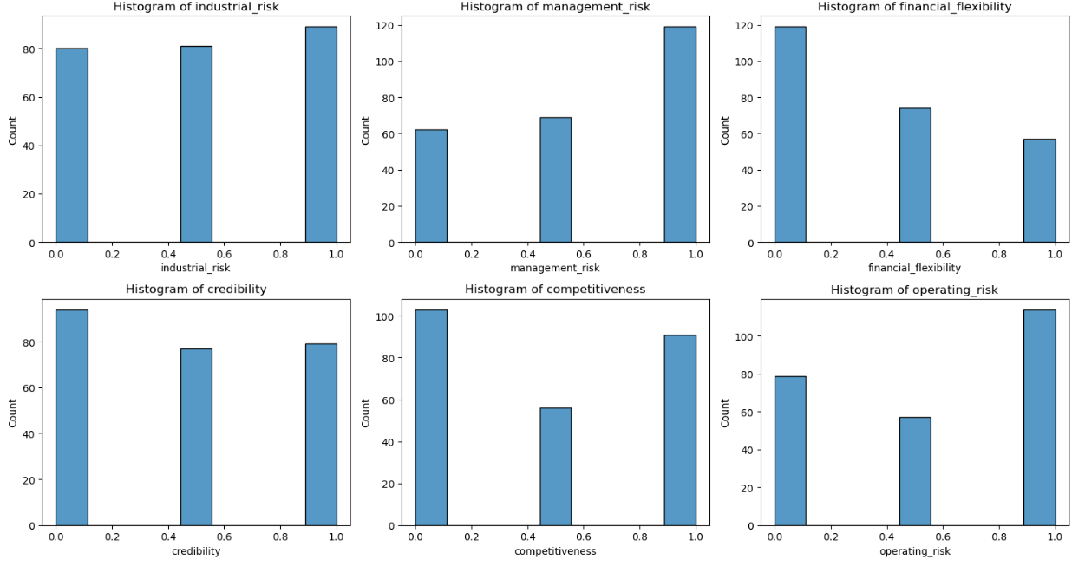
DATA VISUALIZATION
The histograms display the distribution of six different risk-related features: industrial_risk, management_risk, financial_flexibility, credibility, competitiveness, and operating_risk. Each feature has values concentrated at specific levels (0.0, 0.4, 0.8, and 1.0), with some levels having notably higher counts than others, indicating varying degrees of risk concentration across the dataset. For instance, management_risk and operating_risk have the highest counts at the value 1.0, while financial_flexibility has the highest count at 0.0, suggesting specific risk tendencies within the dataset.

Slide 8
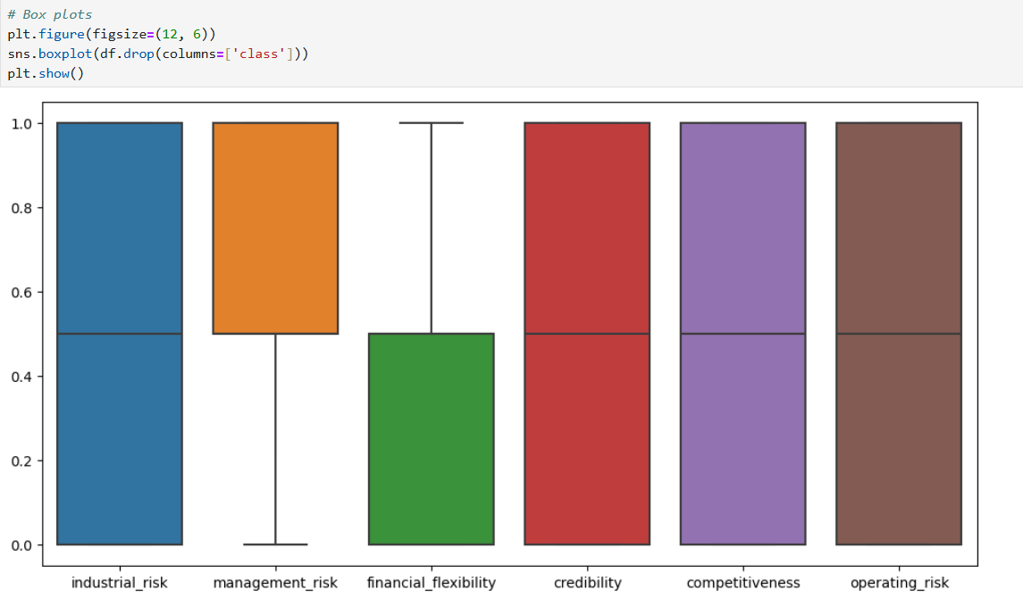
Box Plot
The box plot shows the distribution of six risk-related features in the dataset. Most features have their median values around 0.4 to 0.8, with financial_flexibility having the lowest median at around 0.2.
The data is generally well-distributed with no significant outliers, indicating balanced variability across these risk factors.

Slide 9
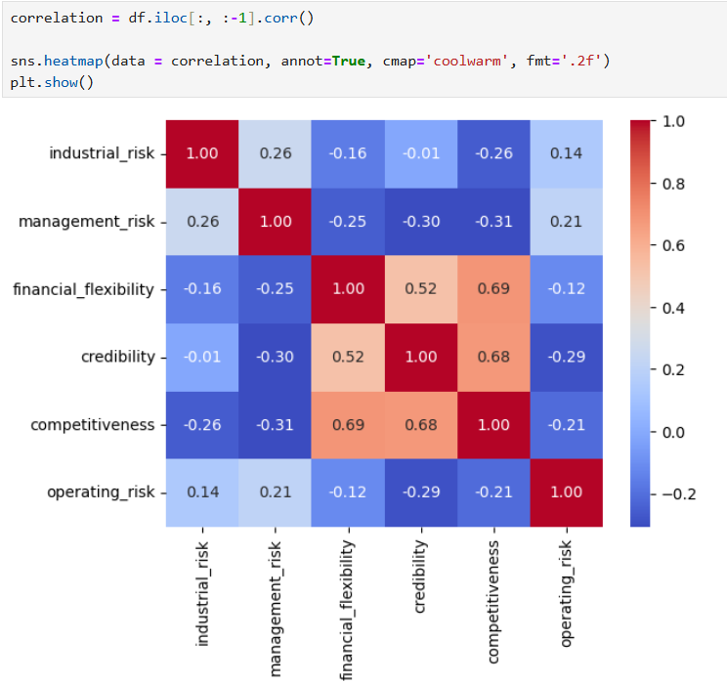
Heat Map
The heatmap shows the correlation matrix for six risk-related features. Financial_flexibility and competitiveness have the highest positive correlation (0.69), indicating they tend to increase together. Most other features have low to moderate correlations, with some negative values, suggesting diverse and varying relationships between the risk factors.

Slide 10


MODEL BUILDING
The following machine learning models were built to predict Bankruptcy Project.
Logistic Regression
Decision Tree Classifier
Random Forest Classifier
SVM Classifier
KNN Classifier
These all models were trained and evaluated using the processed dataset.

Slide 11


MODEL EVALUATION
MM
TYPES OF MODELS | TRAINING ACCURACY | TEST ACCURACY
Logistic Regression | 0.99 | 1.0
2.KNN Classifier | 0.99 | 1.0
3.Decision Tree Classifier | 1.0 | 1.0
4. SVM Classifier | 1.0 | 1.0
5.Random Forest Classifier | 1.0 | 0.99

Slide 12
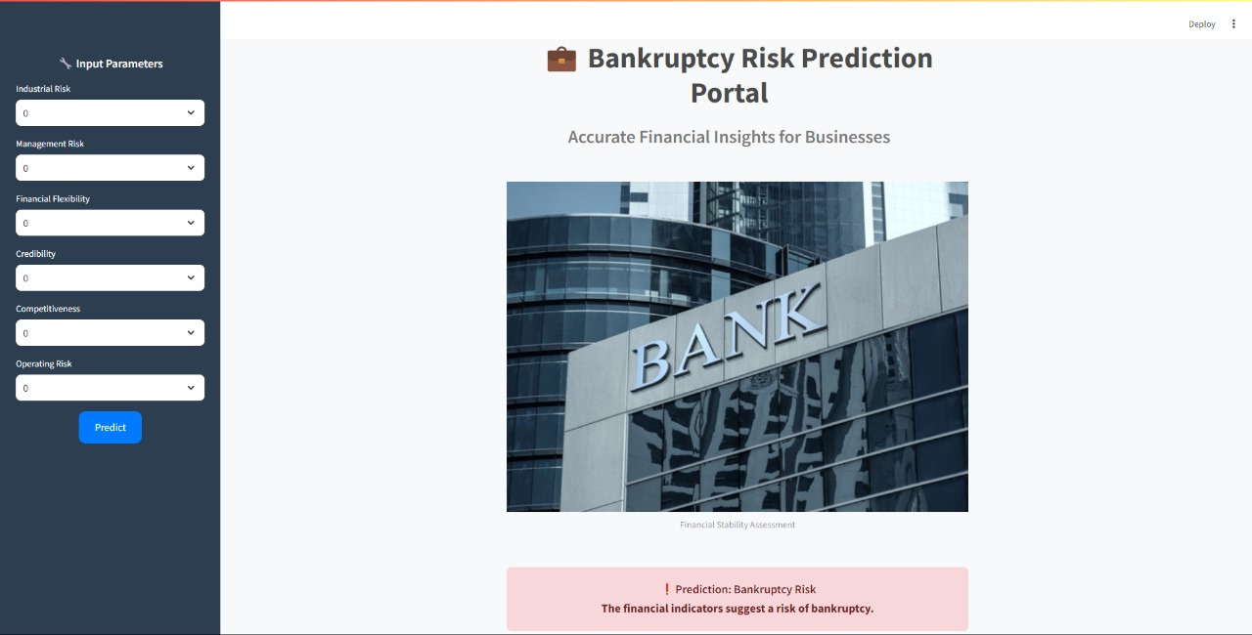
DEPLOYMENT WITH STREAMLITT
Overview of Streamlit:
Streamlit is an open-source app framework for Machine Learning and Data Science projects.
Key Features of the App:
User-friendly interface for Solar Power generation prediction.
Real-time prediction visualization.
User Interaction:
Users can input metrics to get Power generation predictions instantly.
Final Model:
The final model was deployed using Streamlit, allowing for user interaction and real-time predictions.

Slide 13

CHALLENGES
Model Selection and Performance
Several machine learning models were tested, including Logistic Regression, KNN Classifier, Decision
Tree, SVM Classifier, Random Forest Classifier.Each model had its strengths and weaknesses.
Data contains duplicate entries, which need to be identified and removed to maintain data quality.
Content Duplication
Model Versioning
Encountered errors with model versioning, especially with loading saved models that were trained on a different version of scikit-learn.
Random Forest Model, performs better with scaled features. Not scaling data properly could lead to poor predictions.
StandardizatIon
Deployment
Issue
We've faced deployment issues with models and modules.

Slide 14


CONCLUSION
The bankruptcy prediction project successfully developed and evaluated multiple machine learning models to predict the risk of bankruptcy for companies. By thoroughly cleaning the data, Exploratory Data Analysis, and comparing model performances, we identified the most accurate and reliable model of Random Forest Classifier. The deployment of the final model using Streamlit enables real-time predictions, providing valuable insights for stakeholders to take proactive measures. This early warning system can significantly aid in risk management and operational efficiency. The project demonstrates the potential of machine learning in financial risk assessment and decision-making.

Slide 15

THANK YOU

